Slide 1



SWING : Smart Wireless Networking team hosted at INSA-Lyon, CITI
➔ SOCRATE / URBANET (2012)
J-M.Gorce jean-marie.gorce@inria.fr
Evaluation seminar
21-23/03/2012

Slide 2
Swing team
Context in 2009 : A tremendous increase of wireless technologies preparing the convergence toward the big picture of a wireless worldwide web 4W
Swing started at the early 2009
Swing human resources :
  Permanent staff : 8→12
        Embedded systems (2 →3)
        Digital communications (3)
        Networking (2→4)
        Security (1→2)
  PhD students:
    10 defenses ; 15 ongoing thesis
  Temporary staff:
    4 postdocs, 4 engineers
Swing partnerships :
  Industry : Alcatel Lucent Bell Labs , Orange Labs ,
  @Inria : common lab Selfnet & partnerships with Cairn, Dnet, Maestro , Planete, Secret
  5 ANR projects (ARESA, BANET , CORMORAN, ECOSCELLS, RAPIDE)
  1 FUI project (Econhome)
  2 European Marie Curie actions (UoS& UoB , UK / Stevens Institute, USA)
  EquipEx FIT (CorTex platform)

Slide 3
Swing research areas
“The 4W big-picture relies on a cross-layer paradigm”
The Swing approach is transversal:
Toward a flexible SDR node
Distributed algorithms for Agile radio resource allocation
Autonomic networking : MAC&routing protocols, data gathering
Security
Energy
Scalability
Spectrum
Dynamicity
Heterogeneity

Slide 4
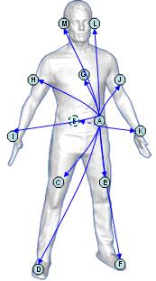
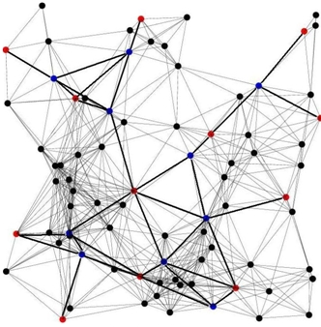
Applicative frameworks
The full convergence is not yet achieved.
➔ Existing technologies are used to address different but complementary issues.
WSN BAN RAN
Large scale network:
Autonomic networking
Security/resilience
Energy efficiency
Small dynamic network:
Channel properties
UWB technologies
(IEEE 802.15.6)
Cooperative communications
Densification &
heterogeneity. 4G+ :
SDR terminal
Distributed resource alloc.
Mesh backbone architecture

Slide 5
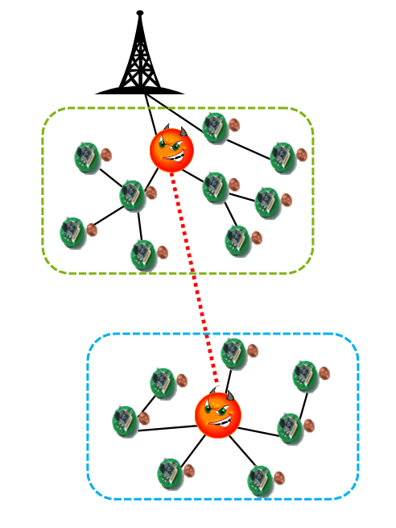
WSN
Autonomic networking, energy saving & security
  Theoretical bounds
    Energy/bit/meter versus Delay/bit/meter
    [IEEE PIMRC 2010, Journal of WCN 2011]
    (from Shannon theory to outage probability)
  Simulations & experiments (WSnet, Hikob, Orange Labs...)
  MAC : a focus on energy efficiency
    CT-MAC [IEEE WCNC2012] multiple channels, IETR/ROLL
  Self-routing : find a route with minimum overload
    Virtual coordinates [Comp Networks 2009]
    0-control routing protocol [IEEE WCNC2012]
  Multiple routes : Network coding & Fountain codes
    Mitigation of
      channel conditions and interference [IEEE com letters]
      attacks and nodes failure [IEEE com letters;IARIA Journal 2011]

Slide 6
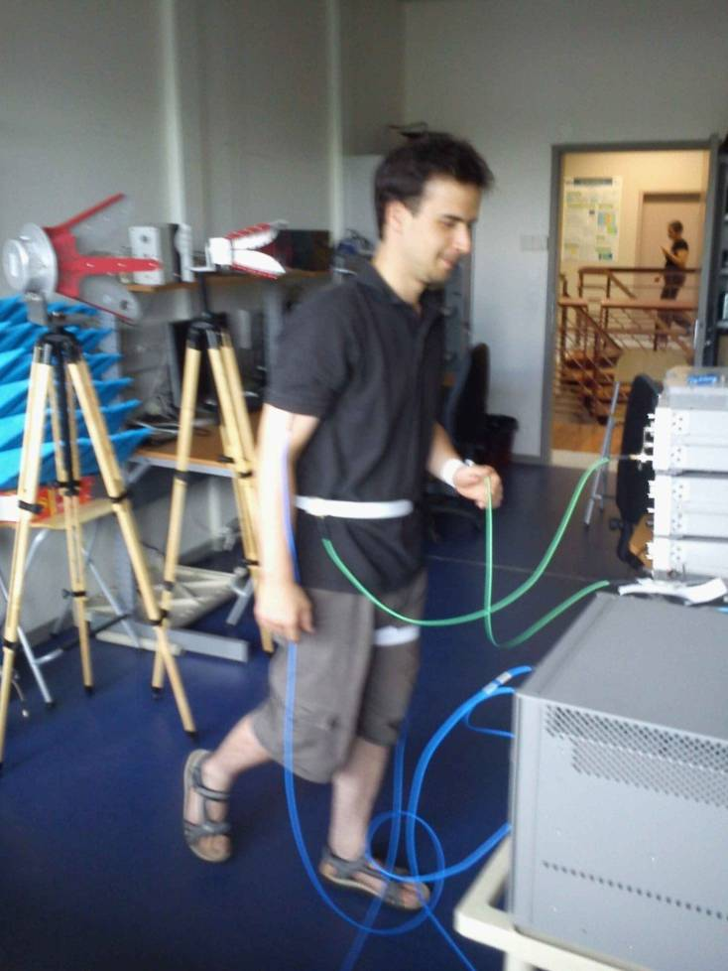
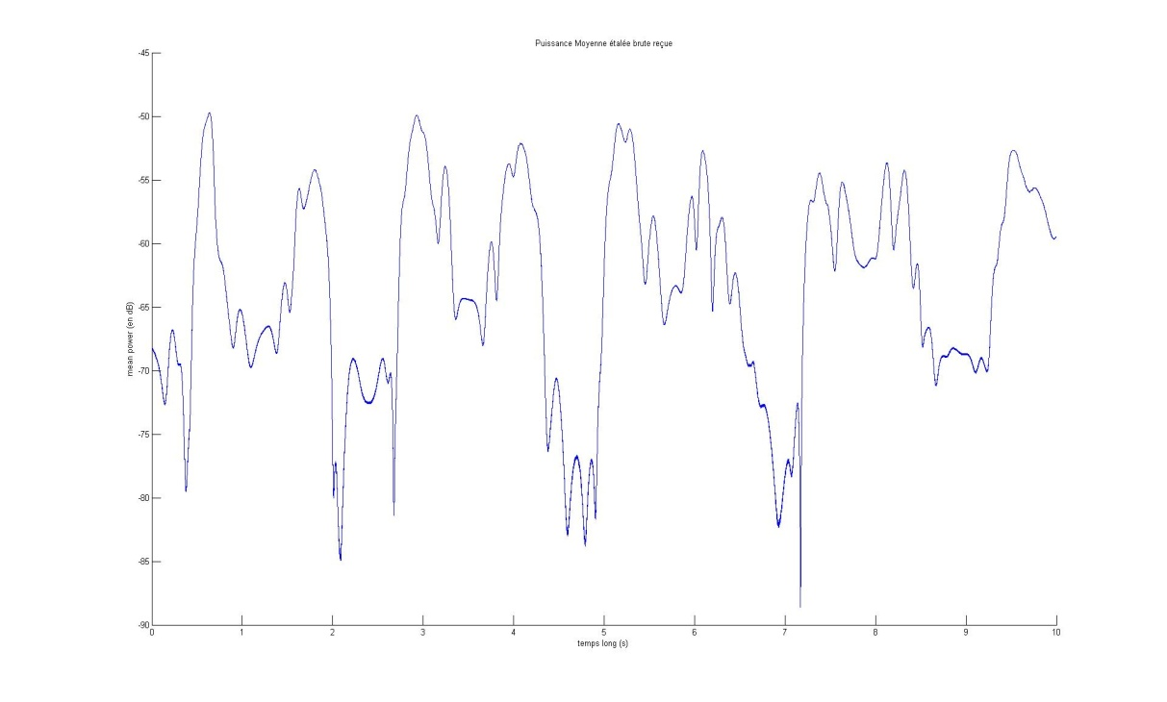
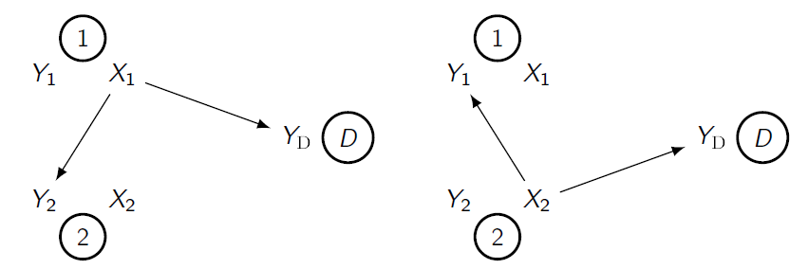
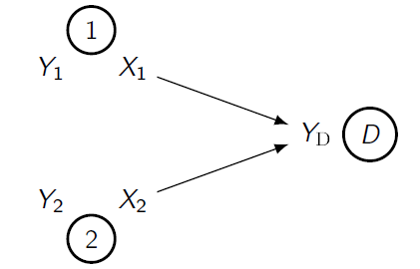
BAN
Adaptive & opportunistic small independent dynamic network
Channel modeling
  Strong shadowing
  UWB model
Security
  A distance bounding
  protocol for UWB
  [IEEE Globecom2010]
Network modeling
  Non geometric graph
  Time-varying
  Correlated links
Cooperative MAC/PHY
  C-MAC Channel
  Relay selection
  [Annals of telecoms 2011]
[C0ST 2100 action]

Slide 7
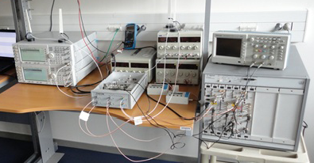
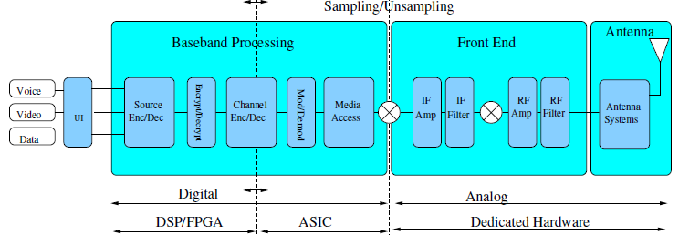
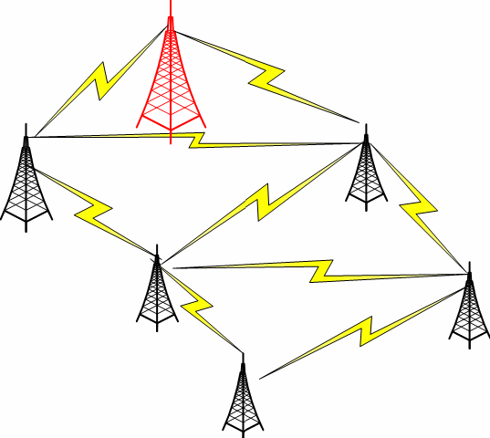
RAN
A dense, heterogeneous self optimized network
An agile terminal for opportunistic radio
[1 patent on SDR and 1 patent on double IQ receiver]
Partners : Orange Labs, CEA LETI
Network architecture
  Dynamic radio resource allocation
Spectral/Power efficiency trade-off
  Mesh network :
Optimizing the Capacity/Energy trade-off
Partners : common lab ALU-INRIA

Slide 8
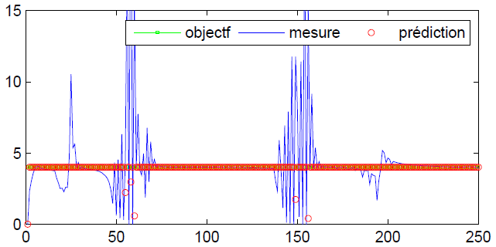
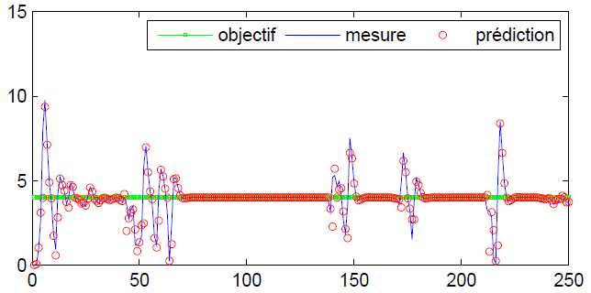
Focus on resource allocation
Distributed resource allocation in 4G network (OFDMA/MIMO)
within the ALU Bell Labs-INRIA common lab & ECOSCELLS project
Objective : fully distributed energy efficient resource allocation
Three approaches
  Gibbs sampling method , in cooperation with
  ALU & TREC [IEEE PIMRC 2011]
  Coalitional games in cooperation with
  E. Altman [WiOpt2011]
  Model Predictive Control [IEEE WCNC2012]
Main ideas :
Tracking the powers’ trajectories
Using trajectory models
Find a trade-off between
reactivity and predictability

Slide 9
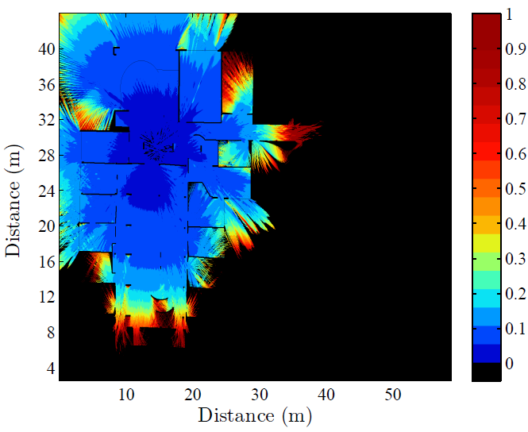
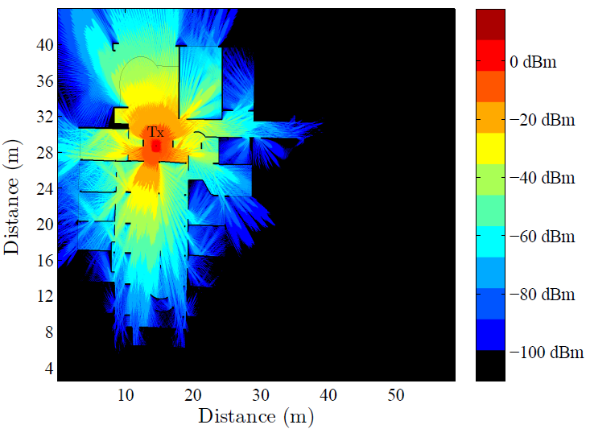

Focus on RAN modeling
Modeling, simulation and perf. evaluation
Delay spread distribution
Power distribution
Channel
statistics
WB
analysis
Laplace transf. Hypergeom. F.
Analytic SEP
SISO :
[IEEE trans Com 2009]
MIMO :
[IEEE trans Com 2011]
Statistical analysis [Eucap2011]
Wideband efficient computation
[in rev IEEE trans A&P]
+
=
Realistic dynamic models

Slide 10
Swing evolution
Two complementary research directions :
URBANET : Urban Networks :
Capillary networks deployed
in urban environment (WMN, WSN, V2I, …)
SOCRATE : Cognitive radio networks :
SDR nodes in their environment
toward radio cognitive networks

Slide 11
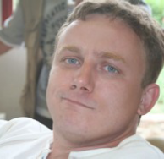
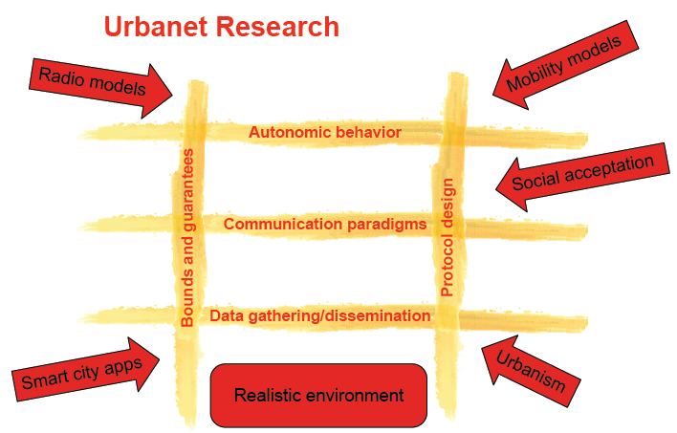
Urbanet:
Networks for Digital Cities
Context and motivation:
  Capillary networks to extend the access network
  To face the need of increasing capacity while reducing energy
  Multi-dimensional sensing for real-virtual worlds duality
  needs for a more diffuse network (like a capillary vascular system) with multi-hops
    Autonomic networking
    Data gathering protocols
    Efficient MAC protocols
    Cross-layer & formal methods
    Optimization techniques
Hervé Rivano

Slide 12
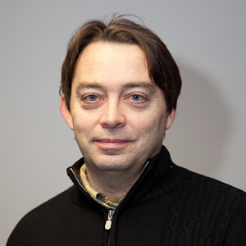
Socrate:
SOftware and Cognitive RAdio for TElecommunications
Context and motivation:
  Obsolescence of current radio networking rules
  Saturation of radio frequency bands
  An appealing approach : « cognitive radio networking »
  Relies on 3 research axes :
    Radio transmission (Antennas, RF front-end…)
    Software (programming issues)
    Signal processing & distributed algorithms (4G+,agility…)
Tanguy Risset

Slide 13

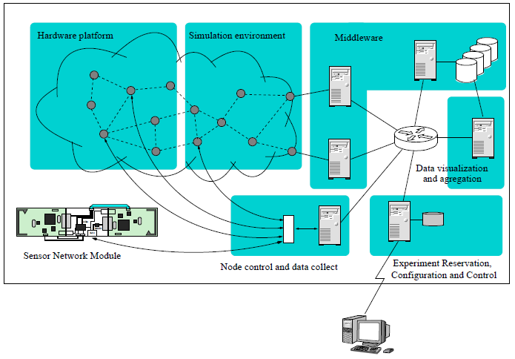
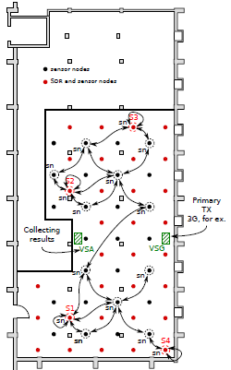
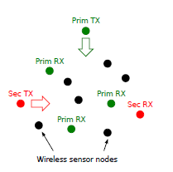
Socrate testbed: CorTex
CorTeX is a part of the FIT EquipEx projet :
  relies on the SensLab design
  but with SDR nodes
  shielded environment
Remote evaluation of cognitive and cooperative radio scenarios
senslab

Slide 14
The teams in their environment
Urbanet
(H. Rivano)
Privatics
(C. Castellucia,
D. Le Metayer)
Networking
Radiocoms
CITI
« Ambiant
Networking »
Security
Socrate
(T. Risset)
Embedded
systems
Middleware
& social networks
Amazones
(S. Frénot)

Slide 15
Swing highlights
Scientific production
10 PhD defenses / 15 on going PhD
32 journal papers
11 book chapters
92 international conference papers
6 patents in cooperation with ALU / Orange Labs / …
Softwares
WSnet: numerous contributions at PHY/MAC/NET levels
Wiplan: simulator (to be connected with WSnet and NS3)
Experimental setups:
a virtual machine on a SOC for SDR
an experimental multi-* receiver
on going : the CorTex testbed
Thank you
for your attention.
Questions ???

